Slide 1
Zika Virus Update
Florida Department of Health (DOH)
(Insert Presenter Name Here)
2016
(Insert DOH Organization Name Here)

Slide 2
Zika Virus
Flavivirus:
Testing has potential for cross-reactivity with other flaviviruses
Originally identified in Africa and Southeast Asia
First identified in Uganda’s Zika Forest in 1947
Transmission
Mosquito – Aedes aegypti, possibly Aedes albopictus
Transmission in the womb and at the time of birth
Sexual
Transfusion cases
Lab exposures
Detected in breast milk, saliva, and urine but no documented transmission
Outbreaks since 2007
Notes:
Flavivirus - 1st isolated in Uganda in 1947 from a Rhesus macaque in Zika Forest. Isolated during a study on yellow fever. Present in Africa and SE Asia – represent two main lineages of the virus. Only total 14 human cases identified in these areas and several countries only have evidence of transmission from serosurvey data. In East Africa – sylvatic cycle between nonhuman primates and several Aedes mosquito species. Humans are the primary amplifying host during outbreaks.
Aedes aegypti believed to be primary vector and other Aedes species have played important roles during recent Western Pacific outbreaks. Aedes albopictus may have the potential to transmit.
2007 – 1st major outbreak on island of Yap in Micronesia. Over 100 confirmed and probable (49+59=108) and 72 suspected = 180). Seroprevalence study (74% pos) estimated that around 73% (over 5,000) of the population had been infected and only 18% had a clinical illness (900).
2013 – outbreak in French Polynesia . Since then, spread to other Pacific Islands, with over 30,000 suspected cases.
Mosquito, perinatal, potential blood transfusion, evidence of sexual transmission – male to female and female to male described too– viral RNA detected in semen. Zika virus RNA has been identified in 3% of asymptomatic blood donors during an ongoing outbreak in French Polynesia.

Slide 3
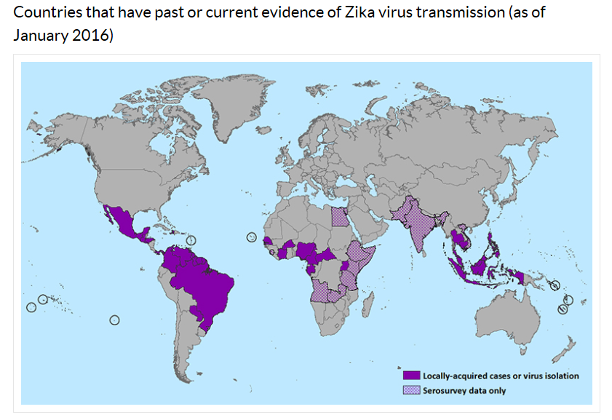
Zika Fever Distribution
Courtesy of CDC.
Notes:
Spread to the Americas in 2015. First locally acquired cases were identified in Brazil, Pan American Health Organization sent out an alert about the cases in May. Since then, locally acquired cases have been identified in Brazil, Colombia, Suriname, Venezuela, French Guiana, Guyana, Paraguay, El Salvador, Guatemala, Honduras, Panama, Mexico, Martinique, Puerto Rico, and Haiti. 20 countries or territories in the Americas, including Puerto Rico
Zika virus infections have been reported in travelers returning to the United States. From 2011–2014, 11 laboratory-confirmed Zika virus disease cases identified in travelers returning to the U.S. from areas with local transmission.
Se next slide for U.S., situation

Slide 4
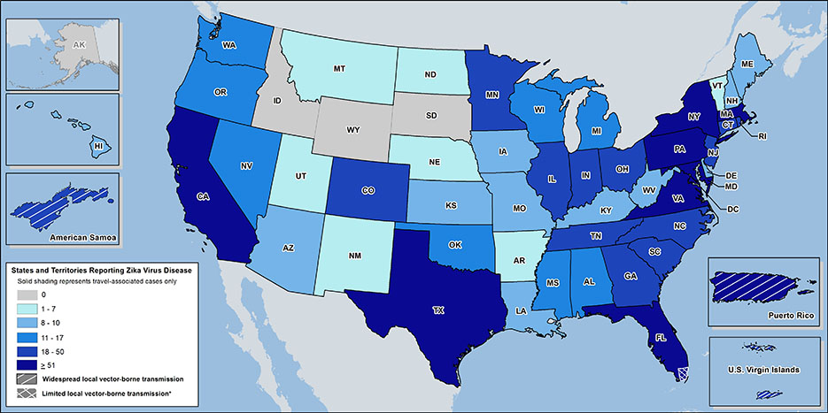
Zika Cases Reported in the United States
Laboratory-confirmed Zika virus disease cases reported to ArboNET by state or territory (as of August 3, 2016)
Courtesy of CDC.
Notes:
Non-travel related infections is 15 and all are in Miami-Dade and Broward County (See latest press release – This quote form 8-4-2016).
US States
Locally acquired mosquito-borne cases reported: 6
Travel-associated cases reported: 1,818
Laboratory acquired cases reported: 1
Total: 1,825
Sexually transmitted: 16
Guillain-Barré syndrome: 5
US Territories
Locally acquired cases reported: 5,525
Travel-associated cases reported: 23
Total: 5,548*
Guillain-Barré syndrome: 18
*Sexually transmitted cases are not reported for areas with local mosquito-borne transmission of Zika virus because it is not possible to determine whether infection occurred due to mosquito-borne or sexual transmission.

Slide 5
General Aedes aegypti and Aedes albopictus Distribution
Courtesy of FDACS
Notes:
This is a general representation and is a bit older. Surveillance in your area is important to know which ones present and your CHD appreciates this information.
Aedes aegypti is found in all of Florida, and the Southeastern and Gulf Coast states. Albopictus has a more northerly range.

Slide 6
Zika Fever Symptoms
Incubation period: 2-14 days
1 in 5 people infected will become symptomatic
Few hospitalizations
Most common signs and symptoms
Fever (often low-grade)
Rash
Joint pain
Red eyes
Muscle ache
Headache
Pain behind the eyes
Vomiting
Notes:
Causes an illness similar to dengue, but the symptoms are milder. Illness characterized by low-grade fever, maculopapular rash (face, neck, trunk, and upper arms, which may spread to the palms and soles), arthralgia, myalgia, and conjunctivitis. Approximately 25-35% of cases may be afebrile. Symptoms resolve over 4-7 days. The most common symptoms of Zika are fever, maculopapular rash, joint pain, or conjunctivitis (red eyes). Other common symptoms include muscle pain and headache.
Characteristic clinical findings are acute onset of fever with maculopapular rash, arthralgia, or conjunctivitis. Other commonly reported symptoms include myalgia and headache. Clinical illness is usually mild with symptoms lasting for several days to a week. Severe disease requiring hospitalization is uncommon and case fatality is low.

Slide 7
Zika Fever (continued)
Presentation similar (but milder) to other illnesses like dengue and chikungunya
Symptomatic treatment
Avoid aspirin and similar drugs (Non Steroidal Anti Inflammatory Drugs)
No vaccine but research underway
Possible link to Guillain-Barré Syndrome (GBS) and poor pregnancy outcomes
Notes:
Few reports of severe disease: Guillain-Barre, meningoencephalitis, autoimmune complications. However, there have been cases of Guillain-Barre syndrome reported in patients following suspected Zika virus infection. 74 patients in the French Polynesia outbreak had presented neurological syndromes or auto-­immune syndromes after the manifestation of symptoms consistent with Zika virus infection.
In July 2015, Brazil reported the detection of patients with neurological syndromes who had recent history of Zika virus infection in the state of Bahia. There were 76 patients with neurological syndromes identified, of which 42 (55%) were confirmed as GBS. Among the confirmed GBS, 26 (62%) had a history of symptoms consistent with Zika virus infection. Now they are up to 121 suspected cases. In January 2016, El Salvador reported the detection of an unusual increase of GBS since early December 2015. On average, El Salvador records 14 cases of GBS per month (169 cases per year), however, between 1 December 2015 and 6 January 2016 there were 46 GBS recorded, of which 2 died.
Based on the typical clinical features, the differential diagnosis for Zika virus infection is broad. In addition to dengue, other considerations include leptospirosis, malaria, rickettsia, group A streptococcus, rubella, measles, and parvovirus, enterovirus, adenovirus, and alphavirus infections (e.g., Chikungunya).
Perinatal DENV transmission can occur, and peripartum maternal infection may increase the likelihood of symptomatic infection in the newborn. Dengue can have harmful effects that include death of the unborn baby, low birth weight, and premature birth. DENV may also be transmitted through breast milk. Most CHIKV infections that occur during pregnancy will not result in the virus being transmitted to the fetus. However, when intrapartum transmission occurs, it can result in complications for the baby, including neurologic disease, hemorrhagic symptoms, and myocardial disease. There are also rare reports of spontaneous abortions after maternal CHIKV infection.
Because of similar geographic distribution and symptoms, patients with suspected Zika virus infections also should be evaluated and managed for possible dengue or chikungunya virus infection. Aspirin and other non-steroidal anti-inflammatory drugs (NSAIDs) should be avoided until dengue can be ruled out to reduce the risk of hemorrhage.

Slide 8
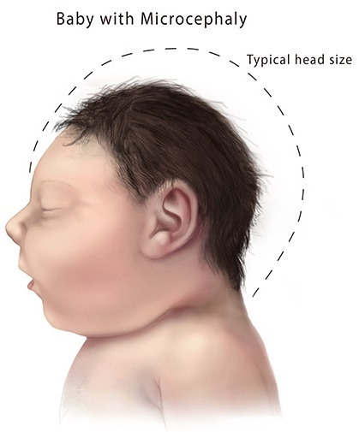
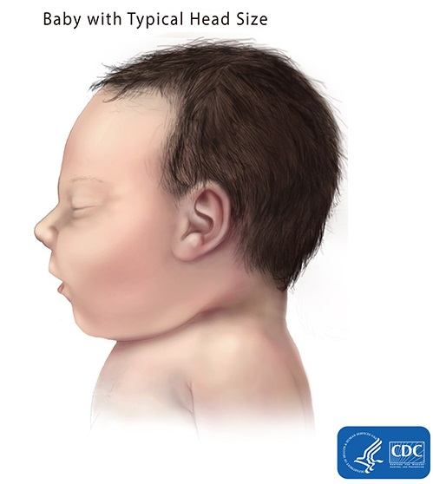
Zika Virus Link to Microcephaly?
http://www.cdc.gov/ncbddd/birthdefects/microcephaly.html
Notes:
Microcephaly is a neurological condition in which an infant’s head is significantly smaller than the heads of other children of the same age and sex, which can lead to developmental issues. Microcephaly can be caused by a variety of genetic and environmental factors, including some infections of the fetus during pregnancy such as toxoplasmosis, cytomegalovirus, rubella and chickenpox.
The Florida Birth Defects Registry reports that the rate of microcephaly in Florida is 6.8 cases per 10,000 live births, which is equal to ~150 cases per year in FL residents.

Slide 9
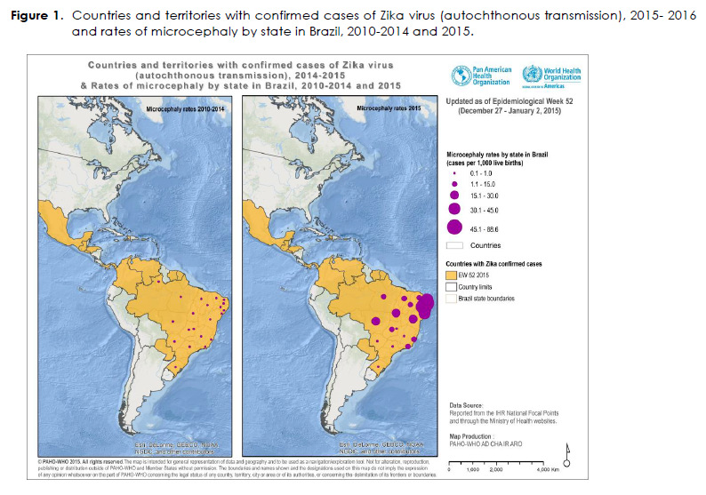
Courtesy of PAHO.
Notes:
According to Brazilian health authorities, as of epidemiological week 1 of 2016, there were 3,530 microcephaly cases recorded, including 46 deaths, in 20 states and the Federal District. Between 2010 and 2014, an average of 163 (Standard deviation 16.9) microcephaly cases was recorded nationwide per year.
The full spectrum of outcomes that might be associated with infection during pregnancy and the factors that might increase risk to the fetus are not yet fully understood. Health authorities in Brazil, with assistance from the Pan American Health Organization, CDC, and other agencies, have been investigating the possible association between Zika virus infection and microcephaly in infants. However, additional studies are needed to further characterize this relationship. More studies are planned to learn more about the risks of Zika virus infection during pregnancy.
CDC scientists tested samples provided by Brazilian health authorities from two pregnancies that ended in miscarriage and from two infants with diagnosed microcephaly who died shortly after birth. For the two full-term infants, tests showed that Zika virus was present in the brain. Genetic sequence analysis showed that the virus in the four cases was the same as the Zika virus strain currently circulating in Brazil. All four mothers reported having experienced a fever and rash illness consistent with Zika virus disease (Zika) during their pregnancies.
Due to concerns of microcephaly associated with maternal Zika virus infection, fetuses and infants of women infected with Zika virus during pregnancy should be evaluated for possible congenital infection and neurologic abnormalities.

Slide 10
CDC Travel Alert/HAN
CDC recommends that women who are pregnant or thinking of becoming pregnant postpone travel to areas with widespread Zika infection.
Travel Alert Level 2-Practice Enhanced Precautions
Pregnant women in any trimester should postpone travel
Women trying to become pregnant should consult healthcare provider before travel
Avoid mosquito bites
http://www.cdc.gov/media/releases/2016/p0801-zika-travel-guidance.html
http://wwwnc.cdc.gov/travel/notices
http://emergency.cdc.gov/han/han00393.asp
EpiCom
Zika Virus Information Hotline is 1-855-622-6735
Notes:
Pregnant women in any trimester should consider postponing travel to the areas where Zika virus transmission is ongoing. Pregnant women who do travel to one of these areas should talk to their doctor or other healthcare provider first and strictly follow steps to avoid mosquito bites during the trip.
Women trying to become pregnant who are thinking about becoming pregnant should consult with their healthcare provider before traveling to these areas and strictly follow steps to prevent mosquito bites during the trip.
Avoid mosquito bites documents link http://www.floridahealth.gov/diseases-and-conditions/zika-virus/_documents/mos-prevention-qxp-02-16.pdf
Florida’s small case cluster is not considered widespread transmission, however, pregnant women are advised to avoid non-essential travel to the impacted area in Miami-Dade County (see map next slide). If you are pregnant and must travel or if you live or work in the impacted area, protect yourself from mosquito bites by wearing insect repellent, long clothing and limiting your time outdoors.

Slide 11
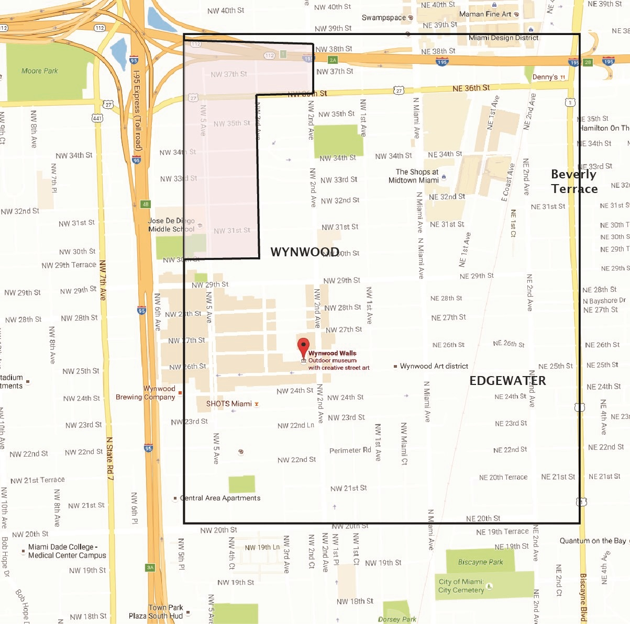
FL Status
Non-travel related infections:15 and all are in Miami-Dade and Broward County (Update as needed - See latest press release – This quote from 8-4-2016).
As of August 5:
338 Travel-Related Infections of Zika (8/5/16 DOH)
15 Non-Travel Related Infections of Zika (8/5/16 DOH)
55 Infections Involving Pregnant Women (8/5/16 DOH)
The department has completed testing in a 10 block area of the northwest quadrant of the one-square mile area and no people within the 10 block radius tested positive.
Notes:
http://www.floridahealth.gov/newsroom/2016/08/080416-zika-update.html
Miami/Broward situation (Press release 8-4-2016)
The department has cleared that area and is continuing to test people within the one-square mile radius. (as of 8/4/16)
The department’s investigation into the non-travel related case outside the one-square mile radius in Miami-Dade County is on-going.
Since the department began our investigation into possible local transmissions of Zika on July 7th, more than 340 individuals in Miami-Dade and Broward counties have been tested for the virus who live or work near the individuals that have already been confirmed with likely mosquito-borne transmissions. (granular information in press release)

Slide 12
Executive Order Number 16-29
Directs State Health Officer (SHO) and Surgeon General to declare Public Health Emergency in 29 counties (duration and geographic boundaries will change as new cases are identified)
Authorizes Commissioner of Agriculture to issue mosquito declaration in same 29 counties
Designates DOH as lead state agency to coordinate emergency response activities among various state agencies and local governments
Directs Department of Environmental Protection and Fish and Wildlife Conservation Commission to support Department of Agriculture and Consumer Services in developing extensive mosquito control plans
Notes:
Governor’s EO issued 3 Feb
Original declaration was for Miami-Dade, Hillsborough, Lee and Santa Rosa Counties, where imported cases of Zika Fever had been reported.

Slide 13
Declaration of Public Health Emergency
Notifies Commissioner of Agriculture of threat to public health from Zika virus transmission to humans from bite of infected Aedes mosquito.
Directs meetings be convened in the impacted counties to discuss mosquito control best practices and outreach to communities with high risk or vulnerable populations
County Health Officers for affected counties develop outreach program for local medical professionals to increase awareness and access to diagnostic tools
Notes:
Issued 3 Feb by State Surgeon General
Required representatives for County Meetings:
County Commission
City Commission
Mosquito control board
County Extension Office
County Health Department
Tourist Development Council
Emergency Management
Airport/Port Authority, as applicable
County Medical Society
Any other necessary community partners such as hospitals

Slide 14
Emergency Rules Noticed
Noticed February 5, 2016
64DER16-1 (64D-3.029) Diseases or Conditions to be Reported
Requires immediate reporting to DOH of suspected or confirmed cases of the Zika virus by physicians, hospitals, and laboratories. Reporting should occur immediately as soon as infection is suspected but does not need to occur after hours.
This is to ensure effective mosquito control efforts can begin as soon as possible to reduce the possibility of local transmission.
Notes:
Issued 5 Feb, 2016
Relates to Chapter 64D-3, Florida Administrative Code
Hospitals and physicians should report to their CHD in a manner similar to other reportable conditions
64DER16-2 (64D-3.040) Procedures for Control of Specific Communicable Diseases: Hospitals with suspected or confirmed cases of the Zika virus shall provide case status reports every 24 hours

Slide 15
Other DOH Response Activities
Partnering with Blood banks statewide and federal partners to ensure blood supply is safe
Field investigation of non-travel related cases and contacts in NW Miami
CDC - DOH
Governor Scott directed DOH to provide Zika testing to pregnant women at all county health departments at no cost (8/3/16)
DOH continues to improve laboratory capacity in-house and through external partnerships
Notes:
The department still believes active transmission is only taking place within the identified one-square mile area in Miami-Dade County. There are no active investigations in Broward County and no areas of active transmission in Broward County.

Slide 16
Other DOH Response Activities
Targeting health care providers
Hospitals
American Congress of Obstetricians and Gynecologists
Midwives/nurses
Working with internal partners
Birth Defects Registry
Maternal and Child Health
Syndromic surveillance
Zika
Guillain-Barrè Syndrome
Microcephaly
Notes:
Shaiasia Notes:
In response to the public health emergency, and given that the vectors, the Aedes species mosquito is present in Florida, the department has been monitoring and working closely with the necessary stakeholders to ensure we stay prepared and ready to respond to the spread of the Zika virus in our state.
The department has provided guidance and support to various healthcare providers to ensure all suspected Zika cases are being identified and reported in a timely manner. Collaborating with our internal and external partners is essential by fostering the exchange of information with various subject matters as well as resources.

Slide 17
Other DOH Response Activities
Response similar to dengue/chikungunya
During interview
Complete travel history
Avoid mosquito bites while ill
Highlight prevention methods
Inform local mosquito control officials of suspect cases
Inform Arbovirus Surveillance Coordinator on suspicion of locally acquired cases
Provide public information on disease, transmission, prevention, protective actions

Slide 18
Other DOH Response Activities
Key partnership with local mosquito control districts
DOH notifies mosquito control upon suspicion of mosquito-borne illness
Appropriate mosquito control measures are implemented
Successful partnership demonstrated previously
Chikungunya 2014
510 imported cases identified
12 sporadic local cases
Coordinated DOH – Local mosquito control activities
No sustained local transmission

Slide 19
Suspected Zika Fever Case Investigation
Sick person
Health care provider
Laboratory
State Laboratory
Case reported
Interview
County Health Department
Mosquito Control
Case finding
Outreach/education
Alerts/advisories
Testing Approval
Department of Health State Office
Response
Subject Matter Experts
Policy Guidance
Case Consultation
Weekly reports
Publish statewide data
Public
CDC
19
Publish nationwide data
Notes:
Assess clinically compatible illnesses for possible travel-associated versus locally-acquired Zika virus infection:
Recent travel: specific dates and locations of travel in the two weeks prior to illness onset
No recent travel: any household contacts (household members or visitors) who have traveled one month prior to illness onset
All specimens that come to BPHL for Zika virus testing will also be tested for dengue and chikungunya and vice versa
If an individual is suspected of having Zika, the healthcare provider should contact their health department immediately upon suspicion to report the case and determine if the patient meets the CDC testing criteria. If they do, the CHD will work closely with the healthcare provider to collect the necessary samples and arrange for them to be sent to the Department Public Health Laboratory for testing. The CHD will also interview the patient to gather any additional information needed. The CHD will also notify the state office and their local mosquito control district of the case. Mosquito control will then provide outreach materials to the community on how they can protect themselves (drain and cover). Additional actions may include, conducting door-to-door inspections of mosquito prevention practices and abundance. The state office will add confirmed cases into the CDC national reporting system; Arbonet and include them the following weekly arbovirus report (available to the public by Tuesday).
This chart depicts the process for evaluation, diagnosis, and reporting, and the inherent complexities associated with any potential Zika case. The complex nature of this disease stresses the need of a coordinated approach between healthcare providers and public health.
Emergency Rules
64DER16-1 (64D-3.029) Diseases or Conditions to be Reported
Requires immediate reporting to DOH of suspected or confirmed cases of the Zika virus by physicians, hospitals, and laboratories
64DER16-2 (64D-3.040) Procedures for Control of Specific Communicable Diseases
Hospitals with suspected or confirmed cases of the Zika virus shall provide case status reports every 24 hours
Physicians with suspected or confirmed cases of the Zika virus shall provide case status reports every 72 hours

Slide 20
FAQ’s: Pregnant Women
Pregnant and nursing women can use EPA-approved mosquito repellent according to label instructions
Information to collect for suspect Zika cases:
Symptoms and onset date
Travel history (throughout pregnancy)
How far along in pregnancy?
Refer to obstetrician for follow up
Test results may not correlate with risk
Notes:
While this condition may be identified by prenatal ultrasound, postnatal confirmation is required. In addition, the absence of microcephalus on prenatal ultrasound does not necessarily mean that it will not be diagnosed after delivery. Cranial ultrasound, CT or MRI scans may also reflect the diagnosis and contribute to the diagnosis of any underlying brain abnormalities.

Slide 21
Requirements for Testing
Guidance is subject to change
At least one symptom (fever, rash, joint pain, red eyes) during/within two weeks of travel to areas with ongoing Zika virus transmission
Pregnant women with/without symptoms tested if travel to or reside in endemic areas
Suspect local cases
Common differential diagnoses have been ruled out
Three of the four major symptoms
Epi-linked to a confirmed or probable case (household)
Notes:
Guidance is subject to change as evidence and understanding of the disease and its complications are better understood
SYMPTOMS!!! Are fever, rash, joint pain and/or conjunctivitis (red eyes)

Slide 22
Laboratory Testing
Commercial testing is available for both PCR (acute infections) and IgM for antibody testing to support detection of infections that may have occurred further in the past.
PCR (detects virus)
Serum and urine sample within 21 days of illness onset
Testing for antibodies against Zika virus
IgM and/or PRNT at CDC
IgM available at BPHL and commercial labs
Notes:
Commercial testing is available.
PRNT -Plaque Reduction Neutralization Test) used to quantify the titre of antibody necessary to neutralize a virus
IgM (Immune Globulin M) Antibody that represents acute or recent infection
4-fold rise in virus-specific neutralizing antibodies in paired sera. Immunohistochemical staining (IHC) for viral antigens or RT-PCR on fixed tissues
Difficult to distinguish infecting virus in people previously infected with or vaccinated against a related flavivirus
Neutralizing antibody testing may discriminate between cross-reacting antibodies in primary flavivirus infections (West Nile, dengue, yellow fever, chikungunya)
Antibody testing looks for immunological memory in your body (exposed to a virus/bacteria)
Antigen testing looks for the presence of the virus/bacteria in your body
PCR (Polymerase Chain Reaction)

Slide 23
Mosquito Bite Prevention
DRAIN water from any containers where water has collected.
CLOTHING: If you must be outside when mosquitoes are active, cover up. Wear shoes, socks, long pants, and long sleeves.
REPELLENT: Apply mosquito repellent to bare skin and clothing. Always use repellents according to the label. Repellents with DEET, picaridin, oil of lemon eucalyptus, para-menthane-diol, and IR3535 are effective. Use netting to protect children younger than 2 months.
See: Mosquito Bite Protection in Florida
www.floridahealth.gov/zika

Slide 24
Available Resources
Zika fever guidance document
Clinician one-pager
Information for obstetricians
Mosquito bite prevention in travelers handouts
FAQs document
DOH Zika Virus webpage: http://www.floridahealth.gov/diseases-and-conditions/zika-virus/index.html
CDC Zika Virus webpage: http://www.cdc.gov/zika/
Notes:
CDC and FDOH have released info for pregnant women and guidance for clinicians.
Blast fax to members of the American Congress of Obstetricians and Gynecologists members but we are also looking into other groups such as midwives.
Distribute to hospitals.

Slide 25
More Information
Insert your contact information here

